Slide 1
COVID-19 Statistics
08-04-2020

Slide 2
Latest Statistics
(updated 08-04-2020)
Total confirmed cases worldwide: 1,510,383
85,008 new cases (5% increase)
Total fatal cases worldwide: 88,325
6,473 new fatalities (7% increase)
Israel recorded 9,404 cases in total
increased by 156 cases (1% increase)
18.0# in confirmed cases, 36.0# in mortality
19.0# in cases per capita, 39.0# in mortality rate

Slide 3
Latest Statistics
(updated 08-04-2020)
Worldwide mortality rate: 5.8% (+0.1%)
Israel mortality rate: 0.8% (+0.1%)
US has most cases in total (429,052)
Italy has most fatal cases in total (US)
US recorded the most new cases (32,829)
US recorded the most new fatal cases (1,973)

Slide 4
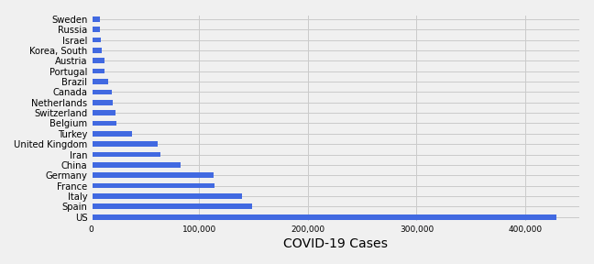
Top 20 countries by number of confirmed COVID-19 cases

Slide 5
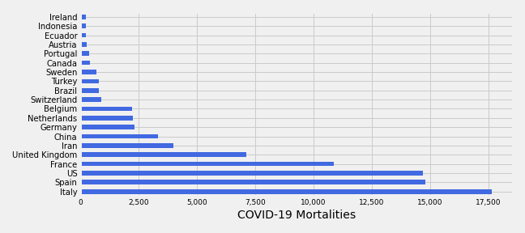
Top 20 countries by number of deathes caused by COVID-19

Slide 6
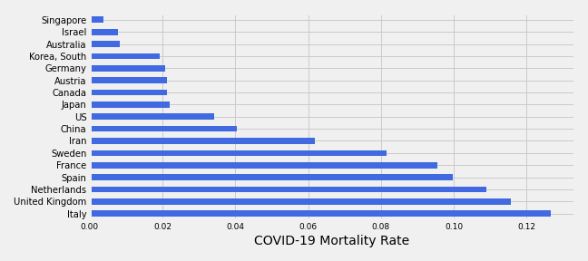
COVID-19 Mortality Rate
Selected Countries

Slide 7
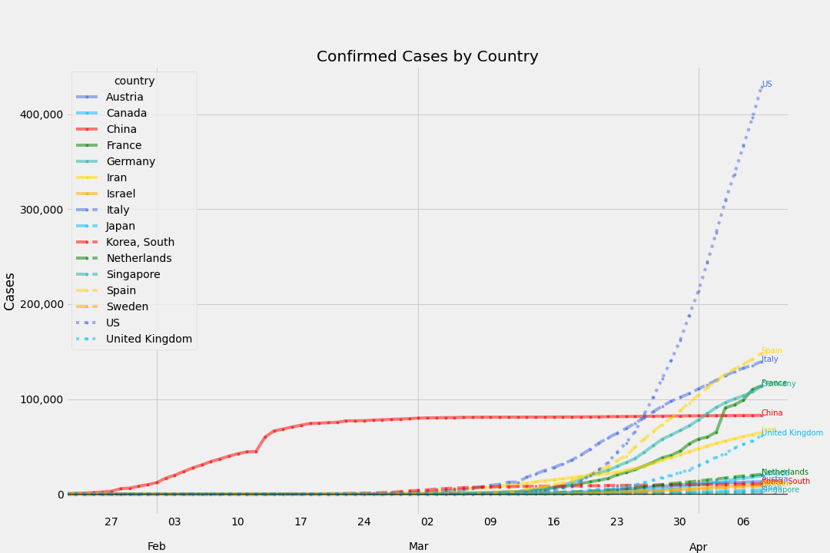
Total Confirmed Cases
By Country

Slide 8
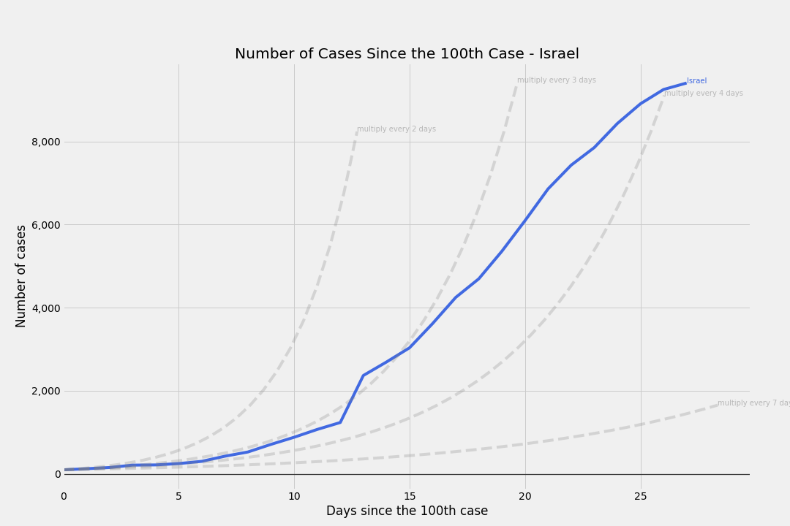
# of cases
Since the 100th case - Israel

Slide 9
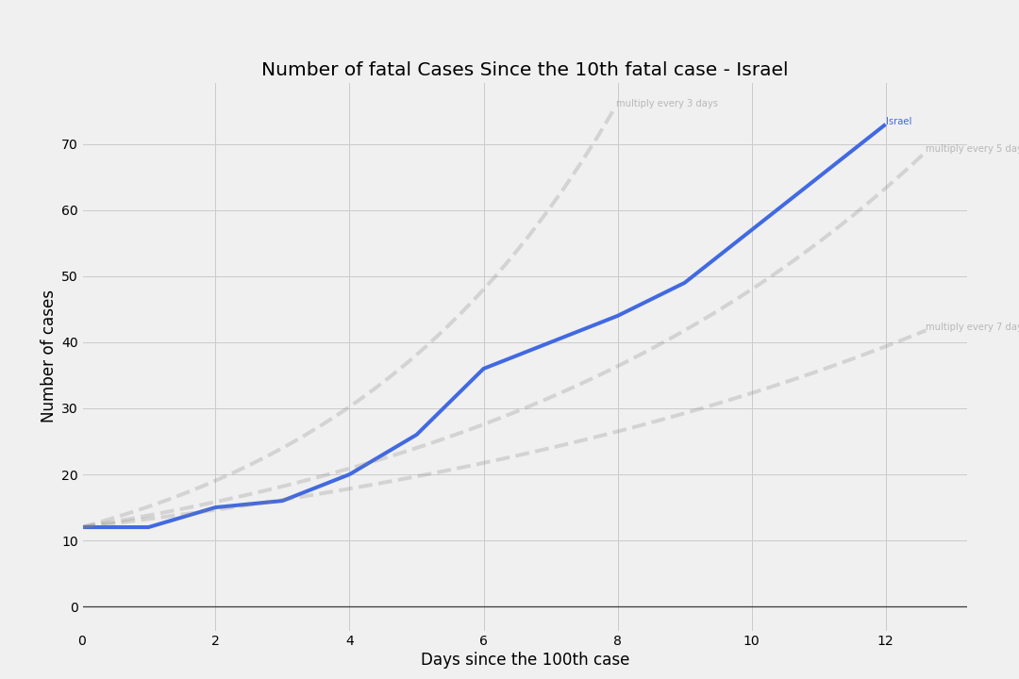
# of cases
Since the 10th fatal case - Israel

Slide 10
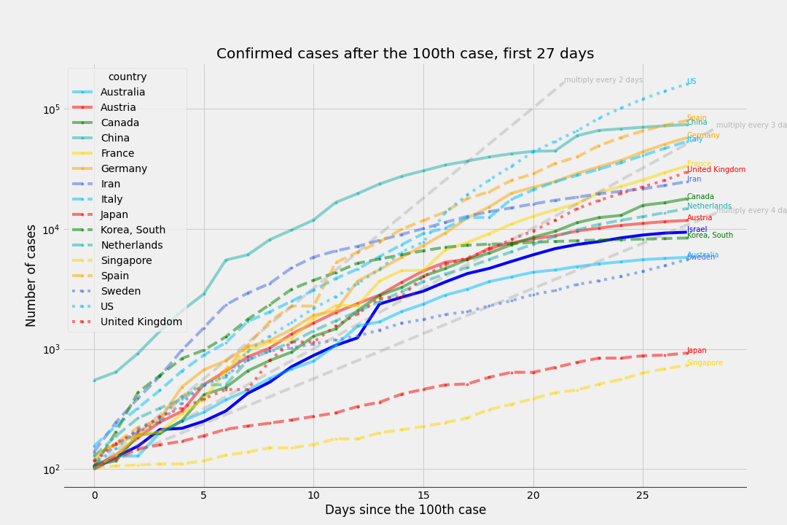
# of cases
Since the 100th case - Israel's timeline

Slide 11
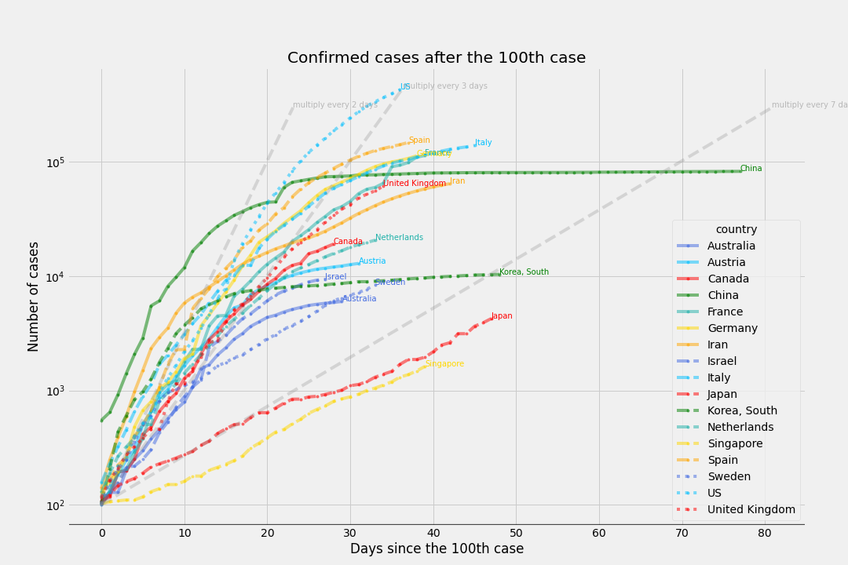
# of cases
Since the 100th case

Slide 12
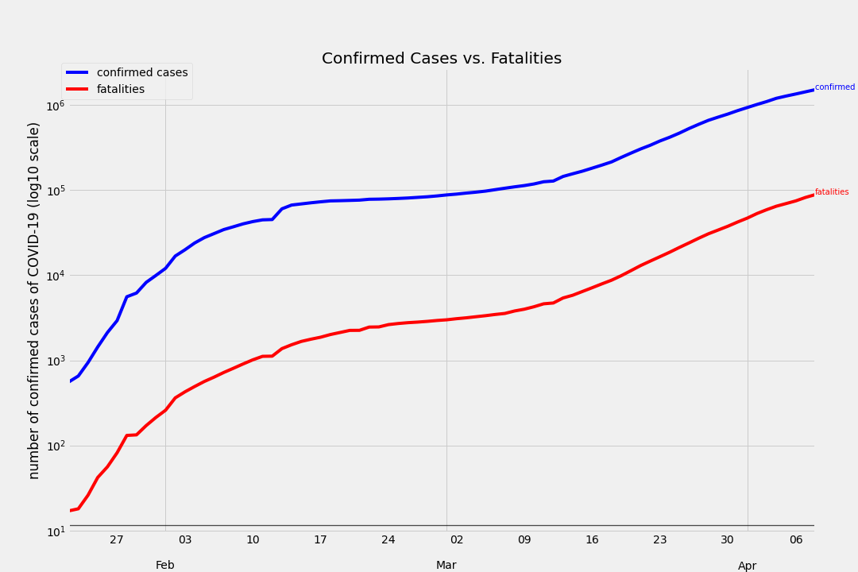
COVID-19 confirmed cases vs COVID-10 fatalities

Slide 13
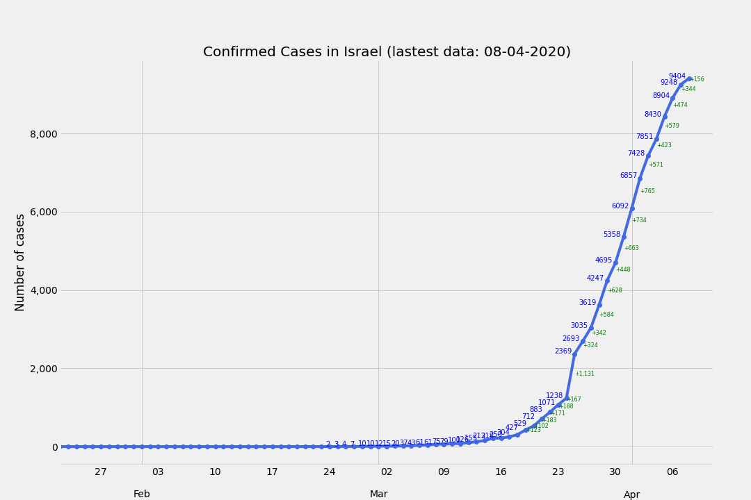
Confirmed Cases in Israel
(latest data2020-04-08 00:00:00)

Slide 14
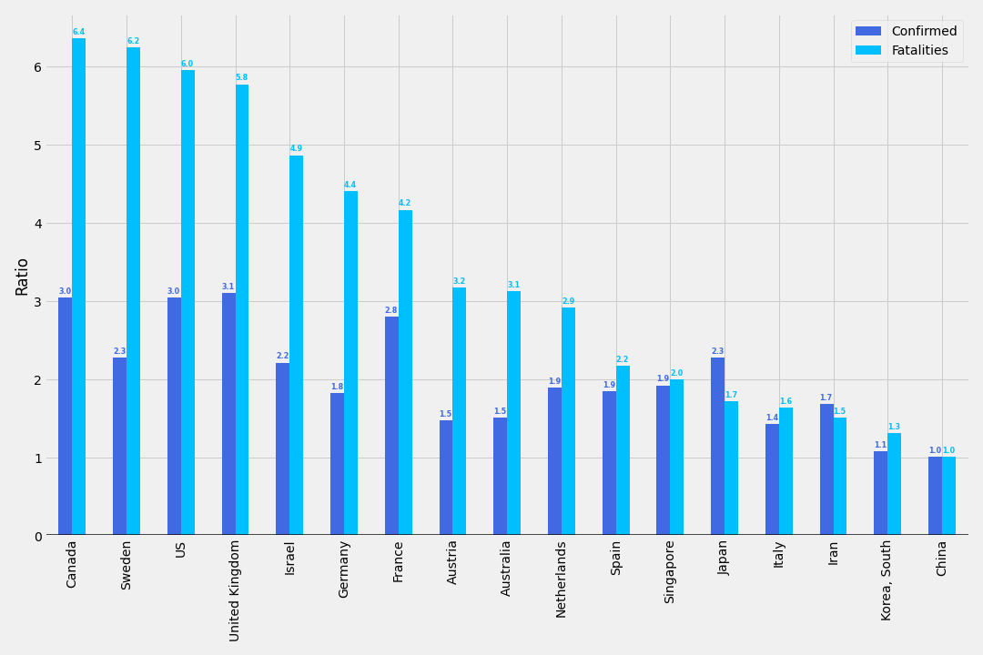
Ratio between today and 10 days ago
Confirmed cases and deaths

Slide 15
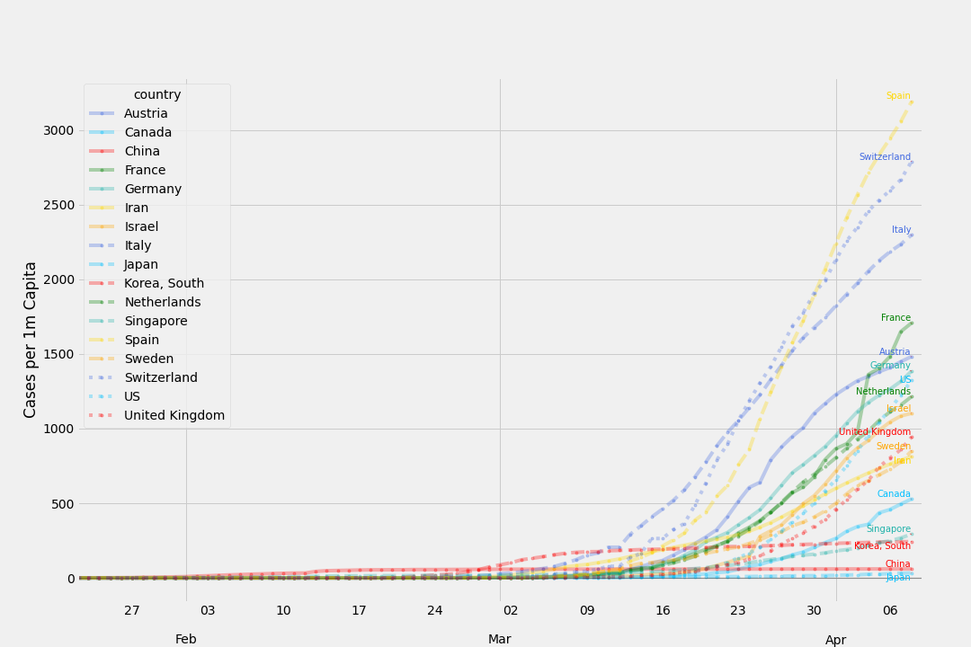
Confirmed Cases by Country
per 1,000,000 ppl

Slide 16
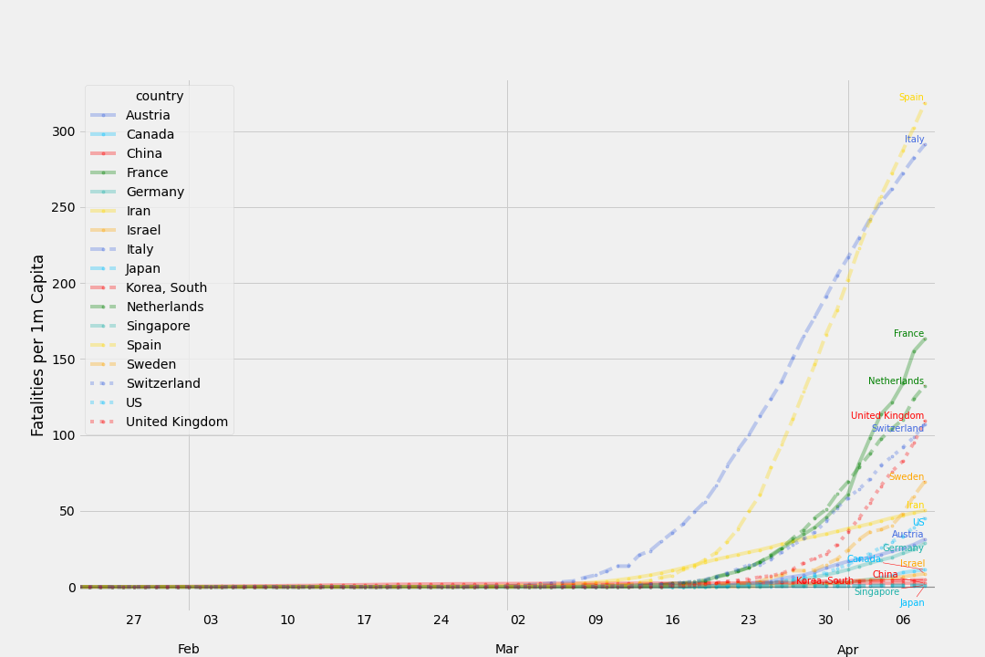
Fatal Cases by Country
per 1,000,000 ppl

Slide 17
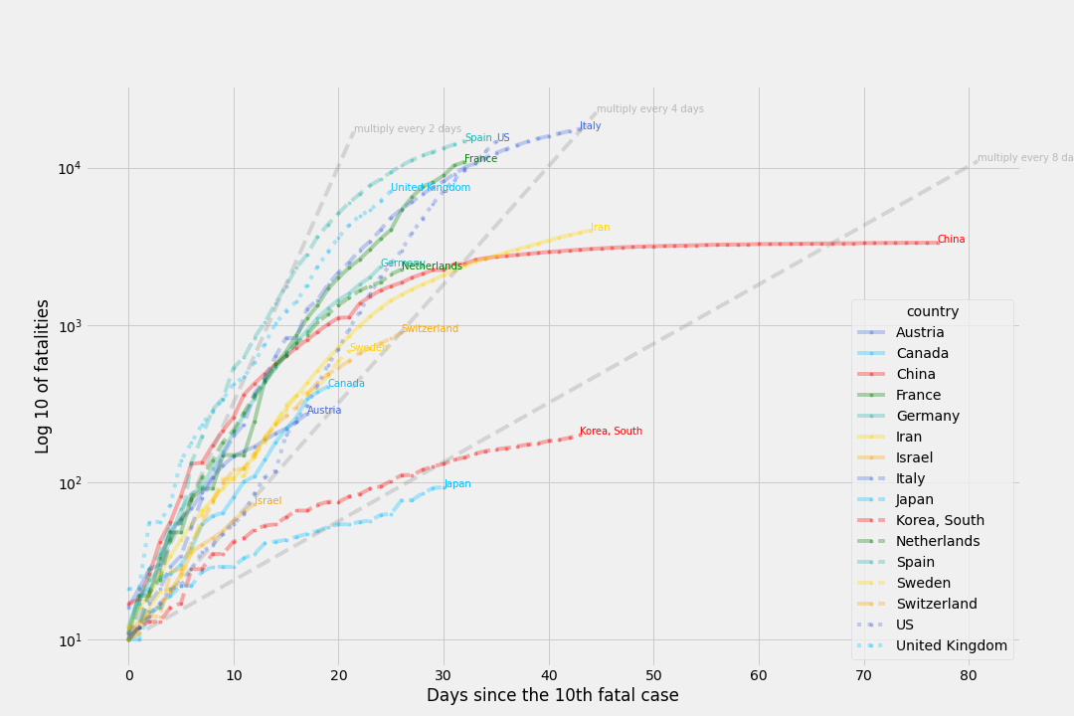
Fatal cases
Since the 10th fatality

Slide 18
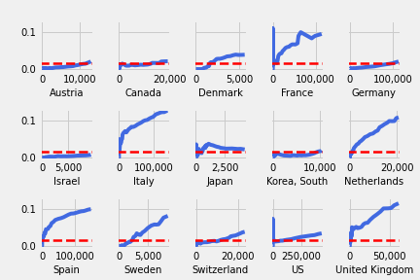
Incrasing number of cases vs mortality rate
Red Line - 1.5% mortality

Slide 19
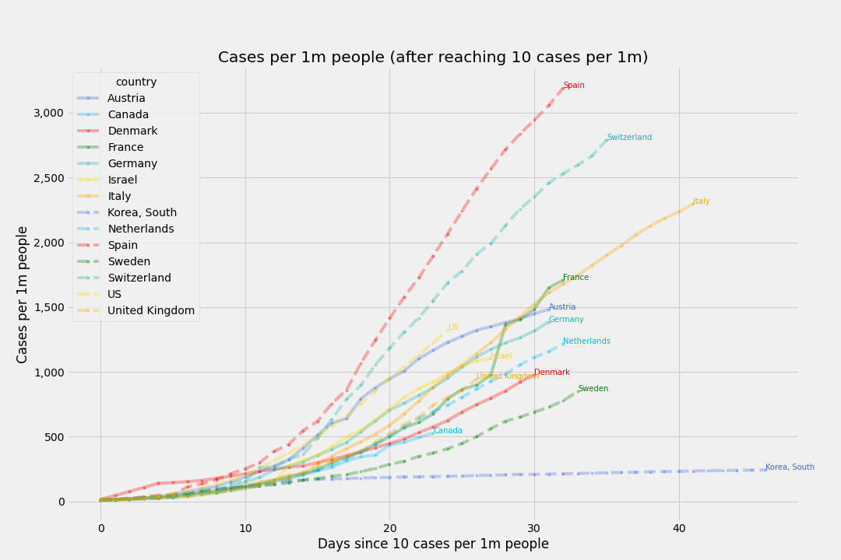
Cases per 1m people
after reaching 10 cases per 1m

Slide 20
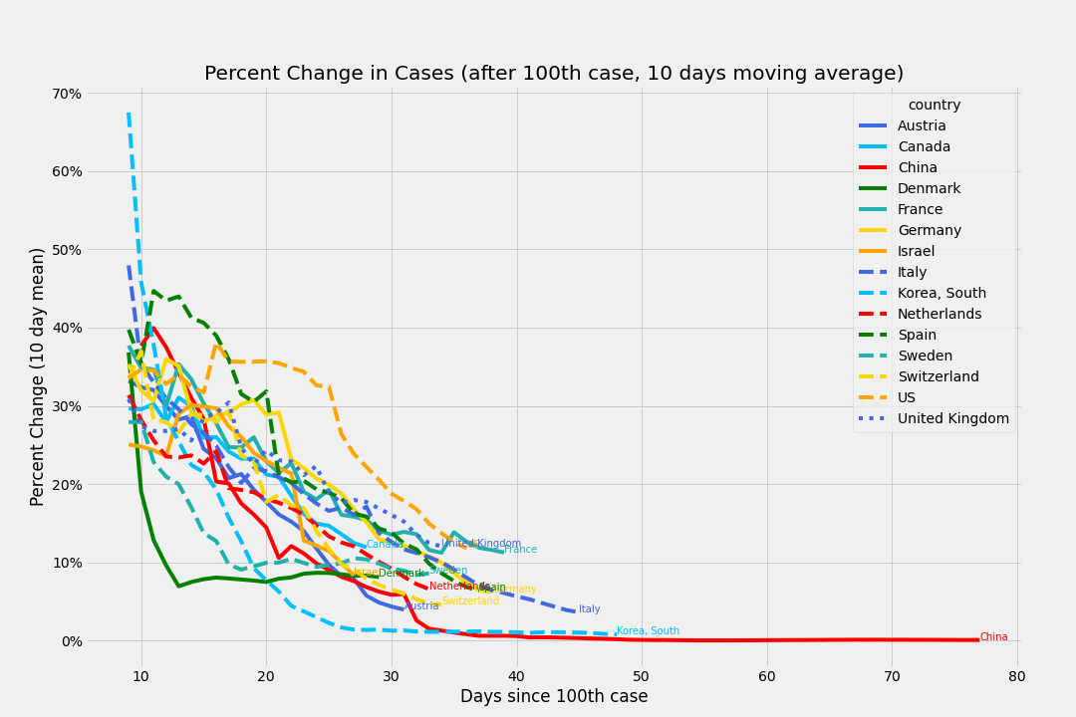
Percent Change in Cases
after 100th case, 10 days moving average

Slide 21
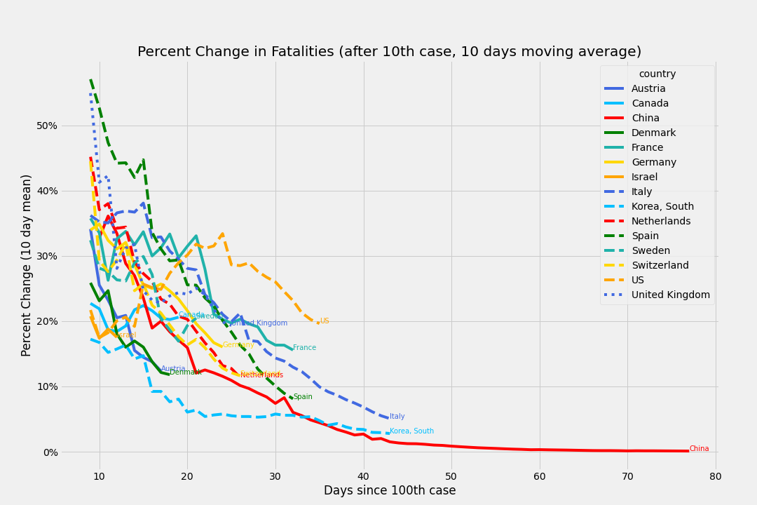
Percent Change in Fatalities
after 100th case, 10 days moving average

Slide 22
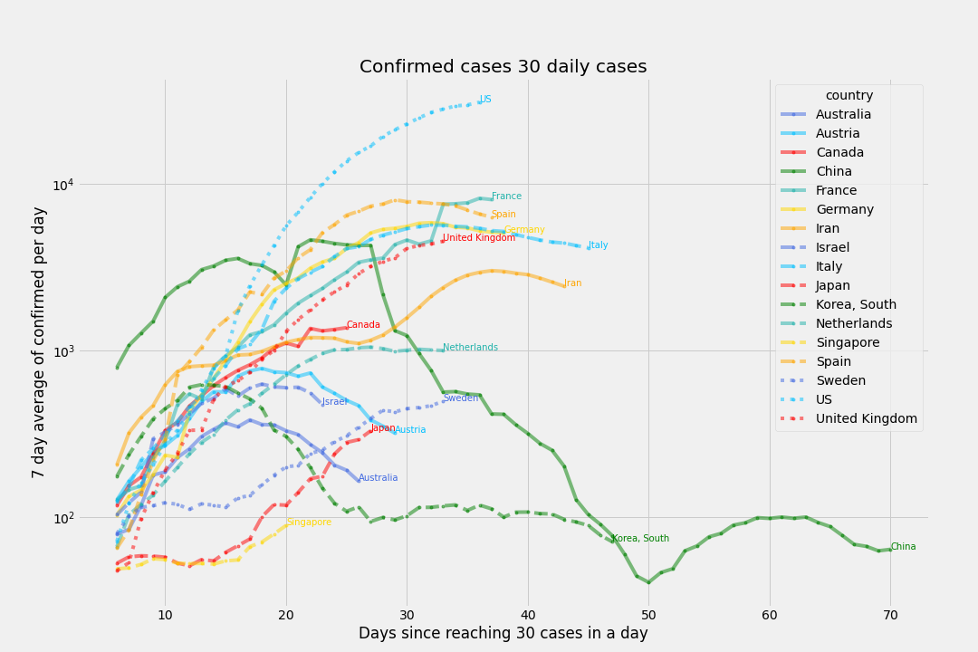
# of deaths per day
Since 3 deaths (7 day moving average)

Slide 23
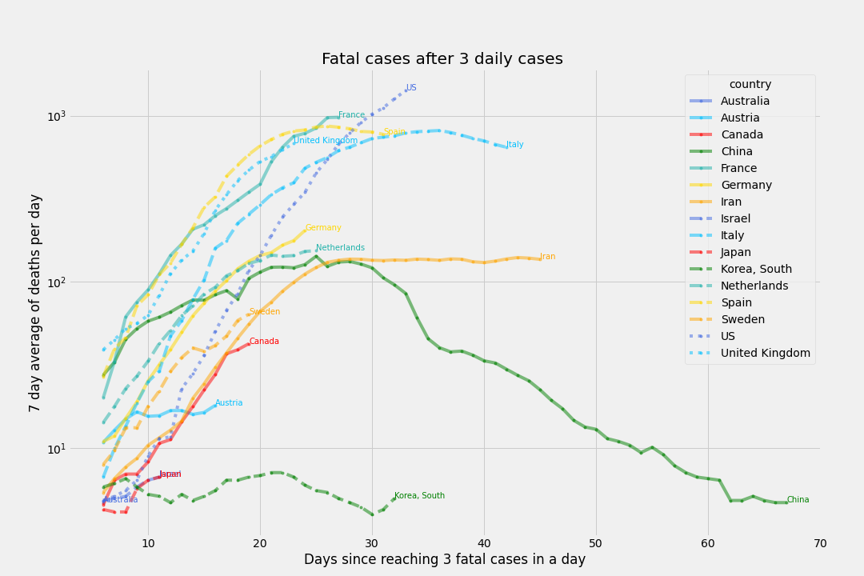
# of deaths per day
Since 3 deaths (7 day moving average)

Slide 24
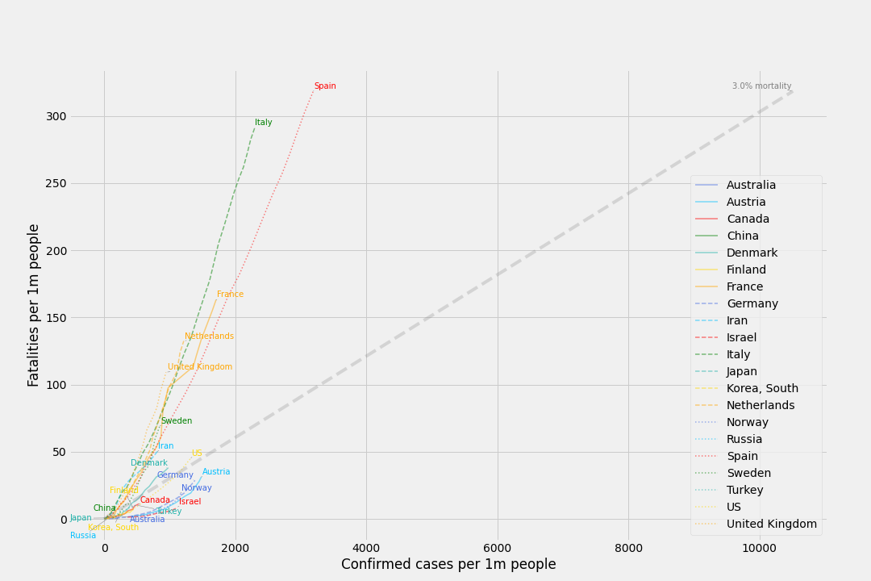
Cases per capita and Mortality per capita
Using 3% mortality rate as reference

Slide 25
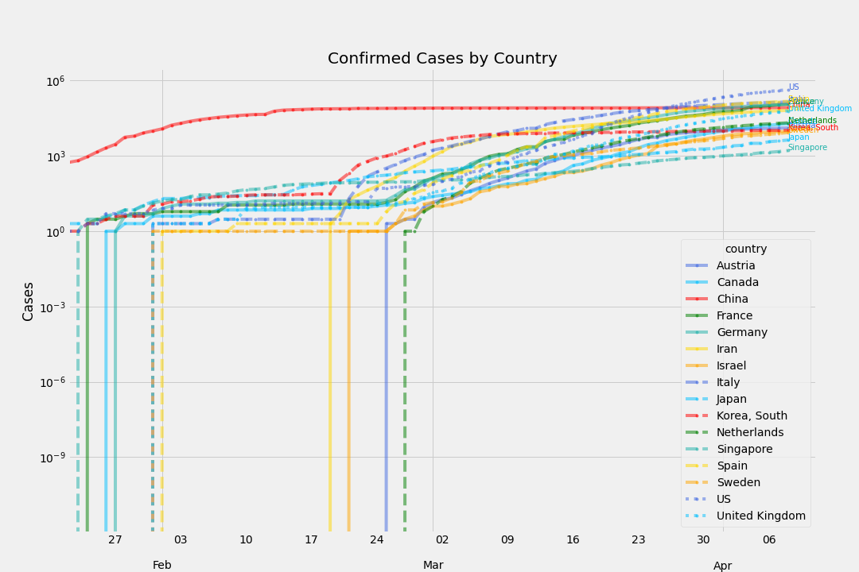
Total Confirmed Cases
By Country

